Slide 1
Dataset
https://www.frontiersin.org/articles/10.3389/frwa.2022.870453/full
A suite of paired physical and chemical datasets collected from 97 river corridors across the globe.

Slide 2
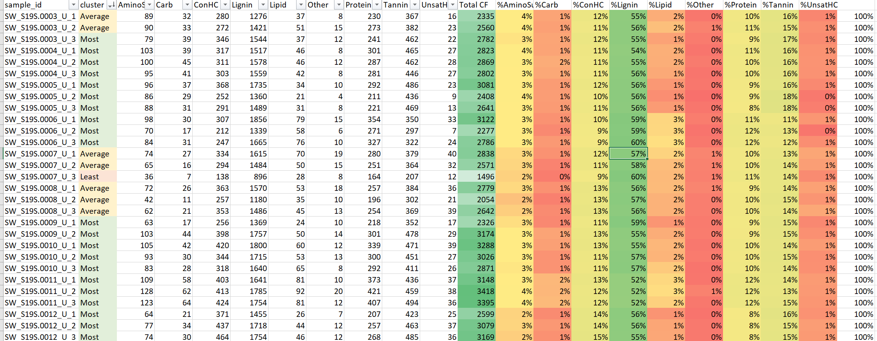
EDA findings
CFs are distributed across sites in similar manner e.g. all sites are dominated by lignin class, followed by Tannin, Protein, ConHC etc.
Site clustering based on richness index (Jaccard) followed analyses on the CFs class distribution reveals similar finding as (1)

Slide 3
Back to research question
Site metadata
Examining the ecological processes influencing the
assembly of molecules into OM assemblages
diversity
Get from unsupervised clustering based on Jaccard indices
How to identify DOM cluster?
What is DOM cluster?
Binary CFs data

Slide 4
Topic 4 – Examining the Ecological Processes Influencing the Assembly of Molecules into OM Assemblages
Dissolved organic matter (DOM) assemblages in freshwaters are formed from complex mixtures of compounds that are highly variable across time and space due to the environmental heterogeneity of river networks and contribution of diverse allochthonous and autochthonous OM sources. We propose that ecologically significant DOM assemblages can be extracted from a continental-scale dataset of fluvial FTICR-MS organic matter molecular characterization, nutrient levels, stable water isotopes (2H and 18O), and other physicochemical parameters. To identify assemblages and trends, we will apply artificial neural networks and machine learning on DOM samples collected across the continental US. Once DOM assemblages are identified we will use variation across space to investigate metabolomic processes in metacommunity ecology and community metabolomes. We will address questions about the origins of DOM assemblages in streams and rivers. Specifically, we will examine the relative importance of biotic vs. abiotic processes, watershed characteristics, coupled nutrient cycles, and sediment metabolism on DOM assemblage formation. We argue that this data-driven approach will reveal common continental-scale DOM assemblages and the metabolomic processes that generate these groups of compounds. Figure 6 shows how we aim to identify assemblages of organic molecules that comprise DOM and relate them to environmental features using artificial neural networks and other machine learning approaches.

Slide 5
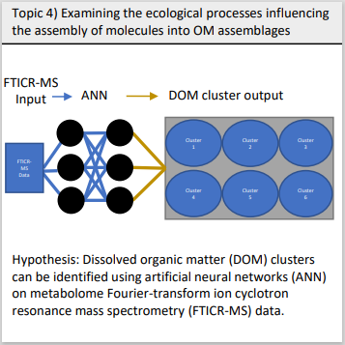
Available datasets
Data:
CF data by site: Presence/absence of CFs
CF metadata: chemical properties and class
Site metadata: (97+) so one site has ~2-3 sample data
ANN Input: Any suitable data
ANN Output: DOM cluster output
Problem: For supervised learning such as ANN or RF, we must know the output first e.g. DOM cluster.
However, our goal is to identify DOM cluster and site-clustering are not equivalent to DOM clustering e.g. all sites are dominated by Lignin etc.
We have achieved site-clustering based on richness index and is able to examine ecological process influencing richness of molecules instead.

Slide 6
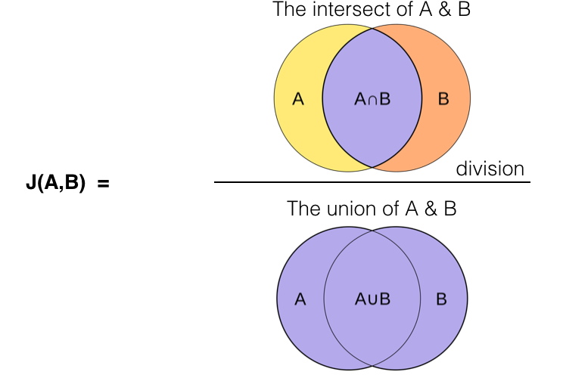
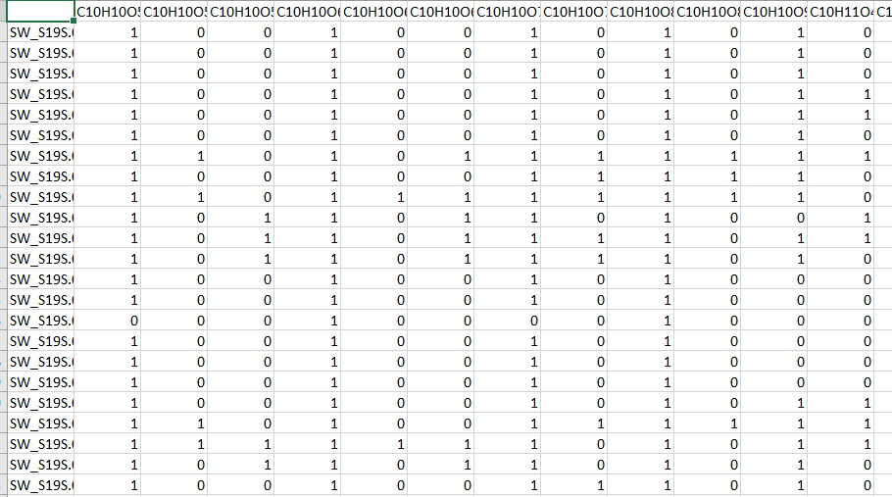
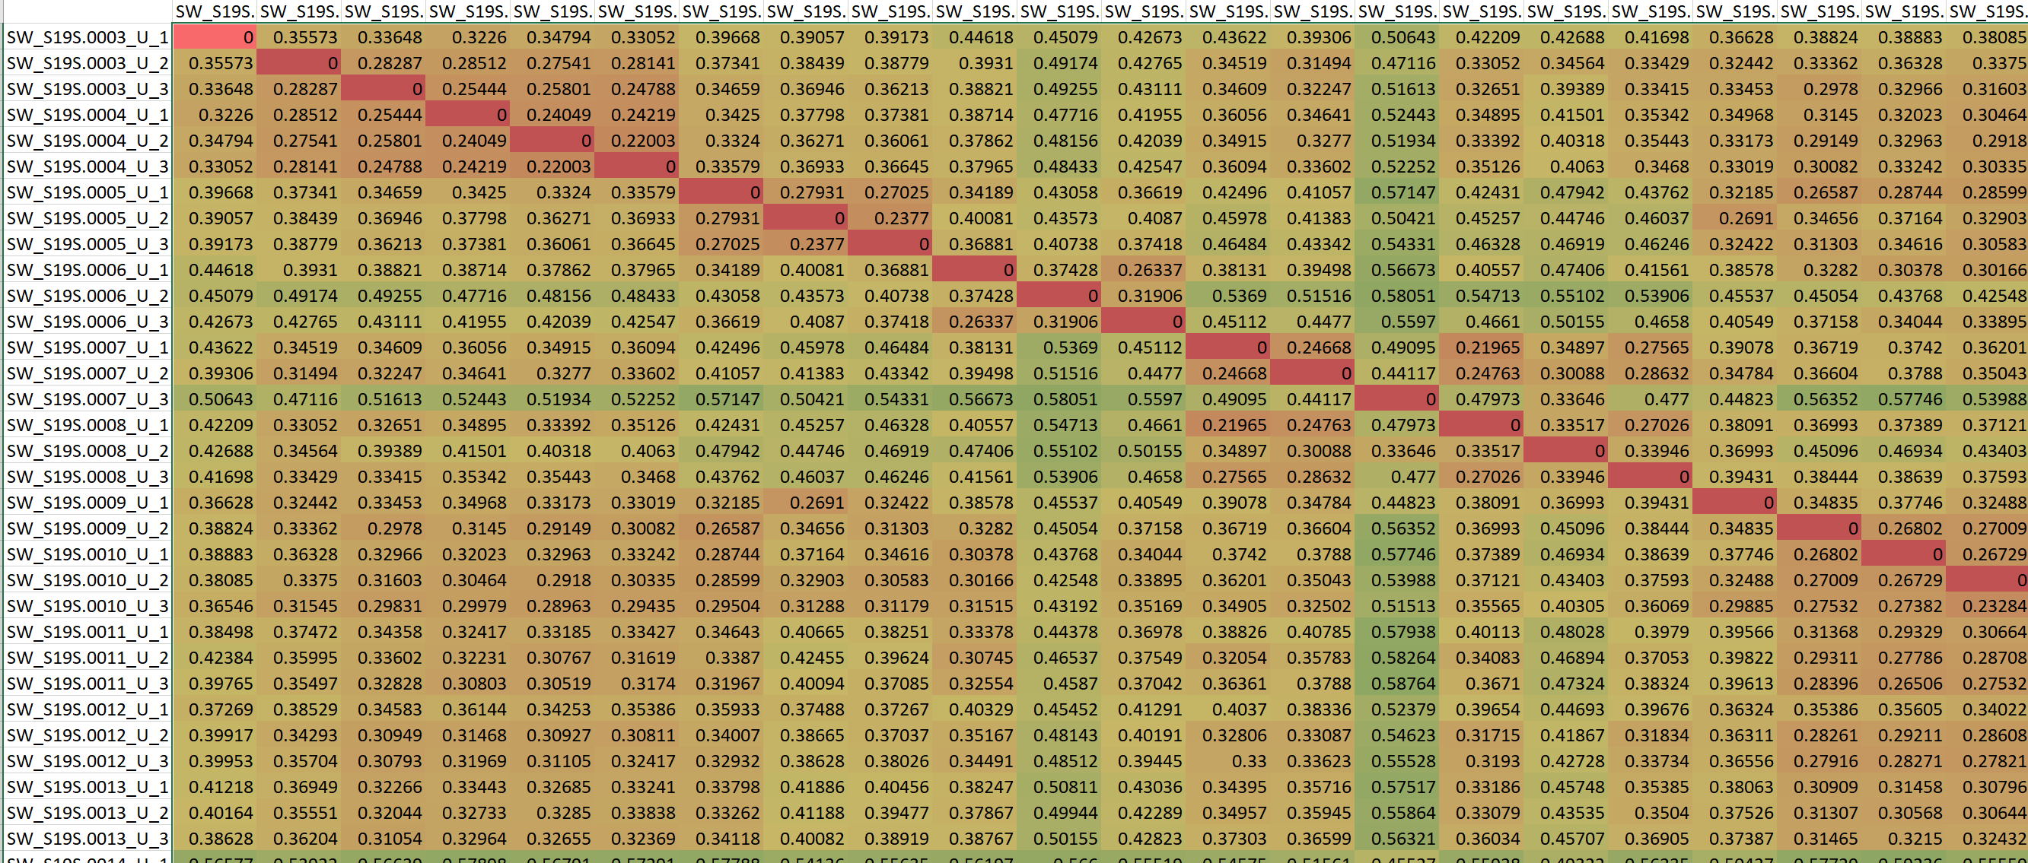
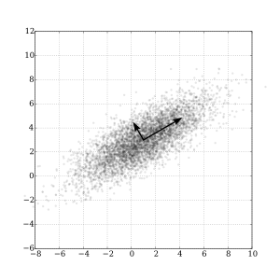
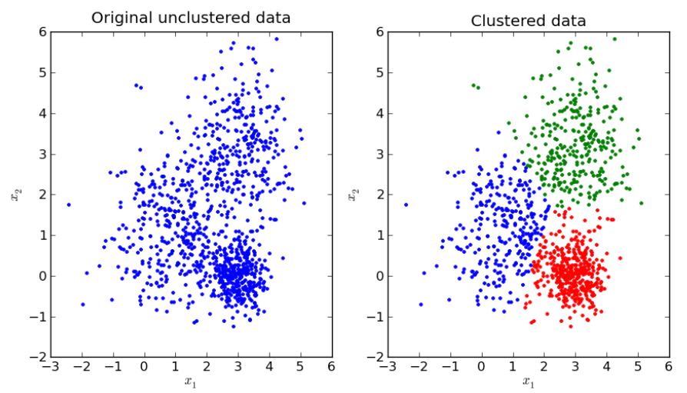
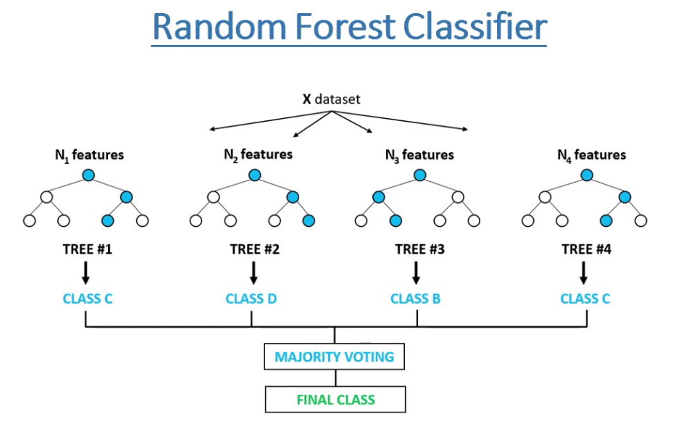
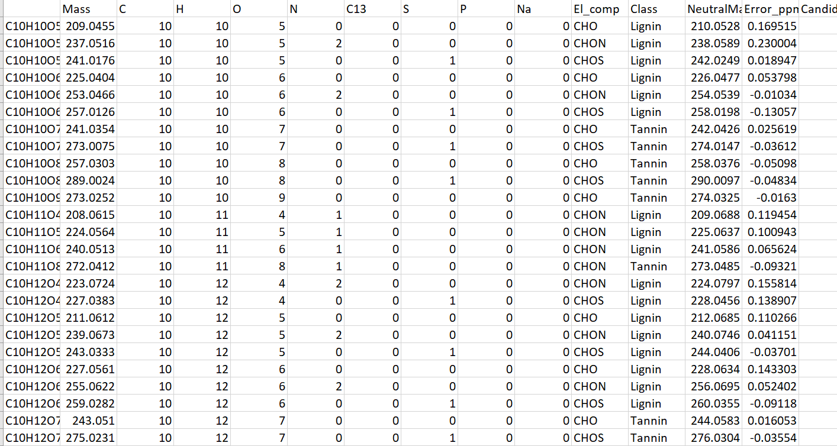
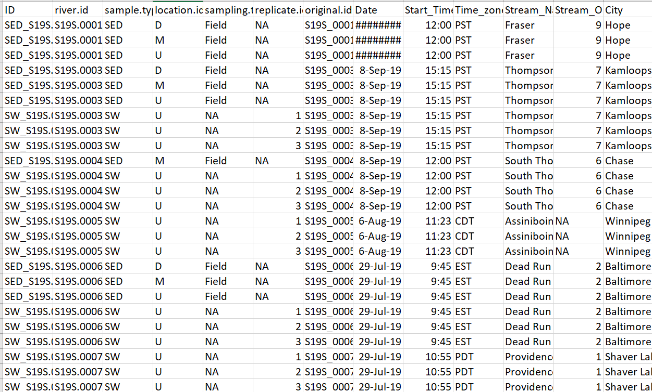
Clustering approach
CF prevalence data by site
Richness index - Jaccard index
Unsupervised-learning
Dimensionality reduction using PCA
K-means clustering
Perform (1) and (2) on both water and sediment separately to generate cluster label as target in supervised learning model
N x N symmetrical square matrix for pairwise Jaccard index by site, representing similarity between sites based on CFs
Examining the ecological processes influencing the diversity of molecules in OM assemblages
(1) Building the ML model and analyze feature importance
(2) Detailed analyses with metadata
CF metadata
Site metadata

Slide 7
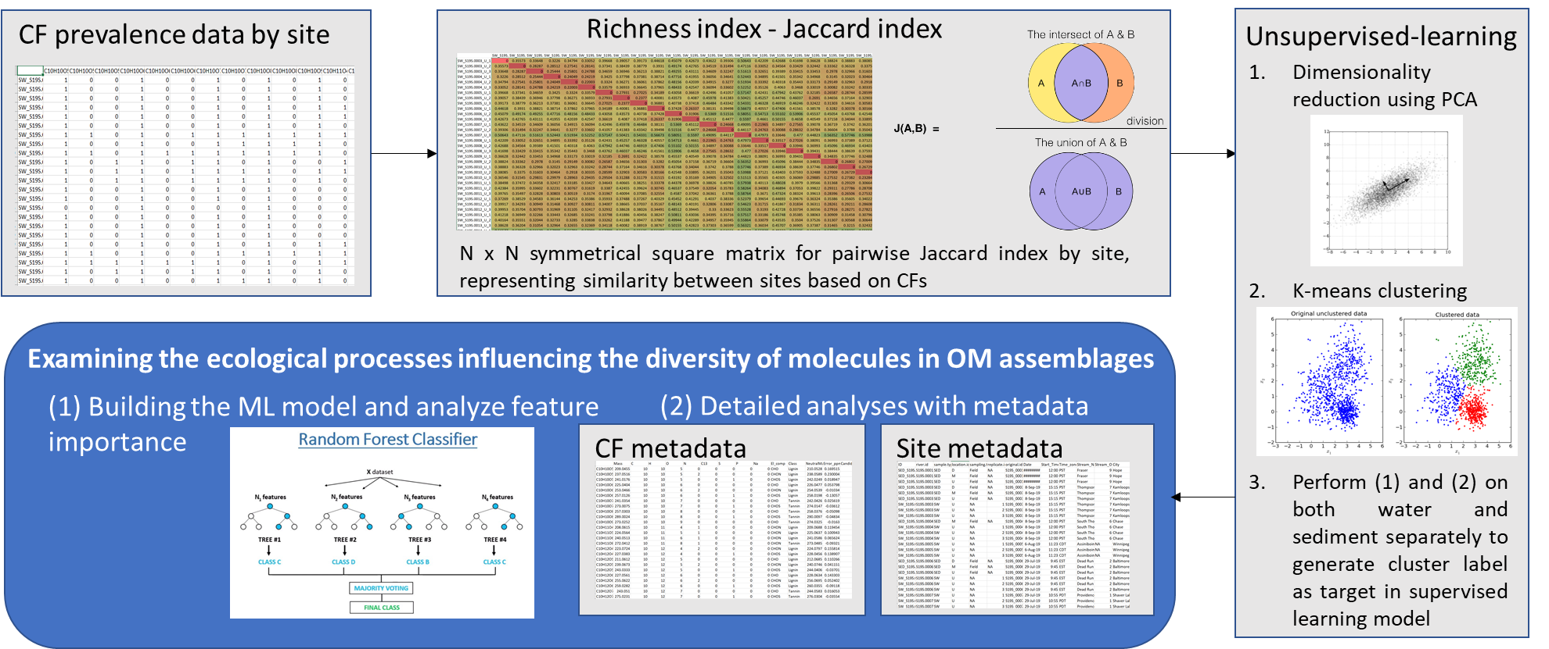

Slide 8
Crosstable data
Mass | GFE
C | kmass.CH2
H | kdefect.CH2
O | NOSC
N | OtoC_ratio
C13 | HtoC_ratio
S | NtoC_ratio
P | PtoC_ratio
Na | NtoP_ratio
El_comp | bs1_class
Class | bs2_class
NeutralMass | bs3_class
Error_ppm | delGcox0PerCmol
Candidates | delGcoxPerCmol
AI | lamO20
AI_Mod | lamO2
DBE | delGd0
DBE_O | delGd
DBE_AI | n.mf
OM assemblages
https://www.frontiersin.org/articles/10.3389/frwa.2022.870453/full
That is, OM is a collection of molecules that are assembled through molecular production (analogous to birth), transformation (analogous to death), and transport (analogous to dispersal). Therefore, the “community structure” of OM composition can likely be used to study the underlying hydrobiogeochemical processes regulating the OM assemblage. These conceptual parallels and congruent data structures provide a strong motivation to study OM chemistry by asking questions comparable to those pursued in community ecology.

Slide 9
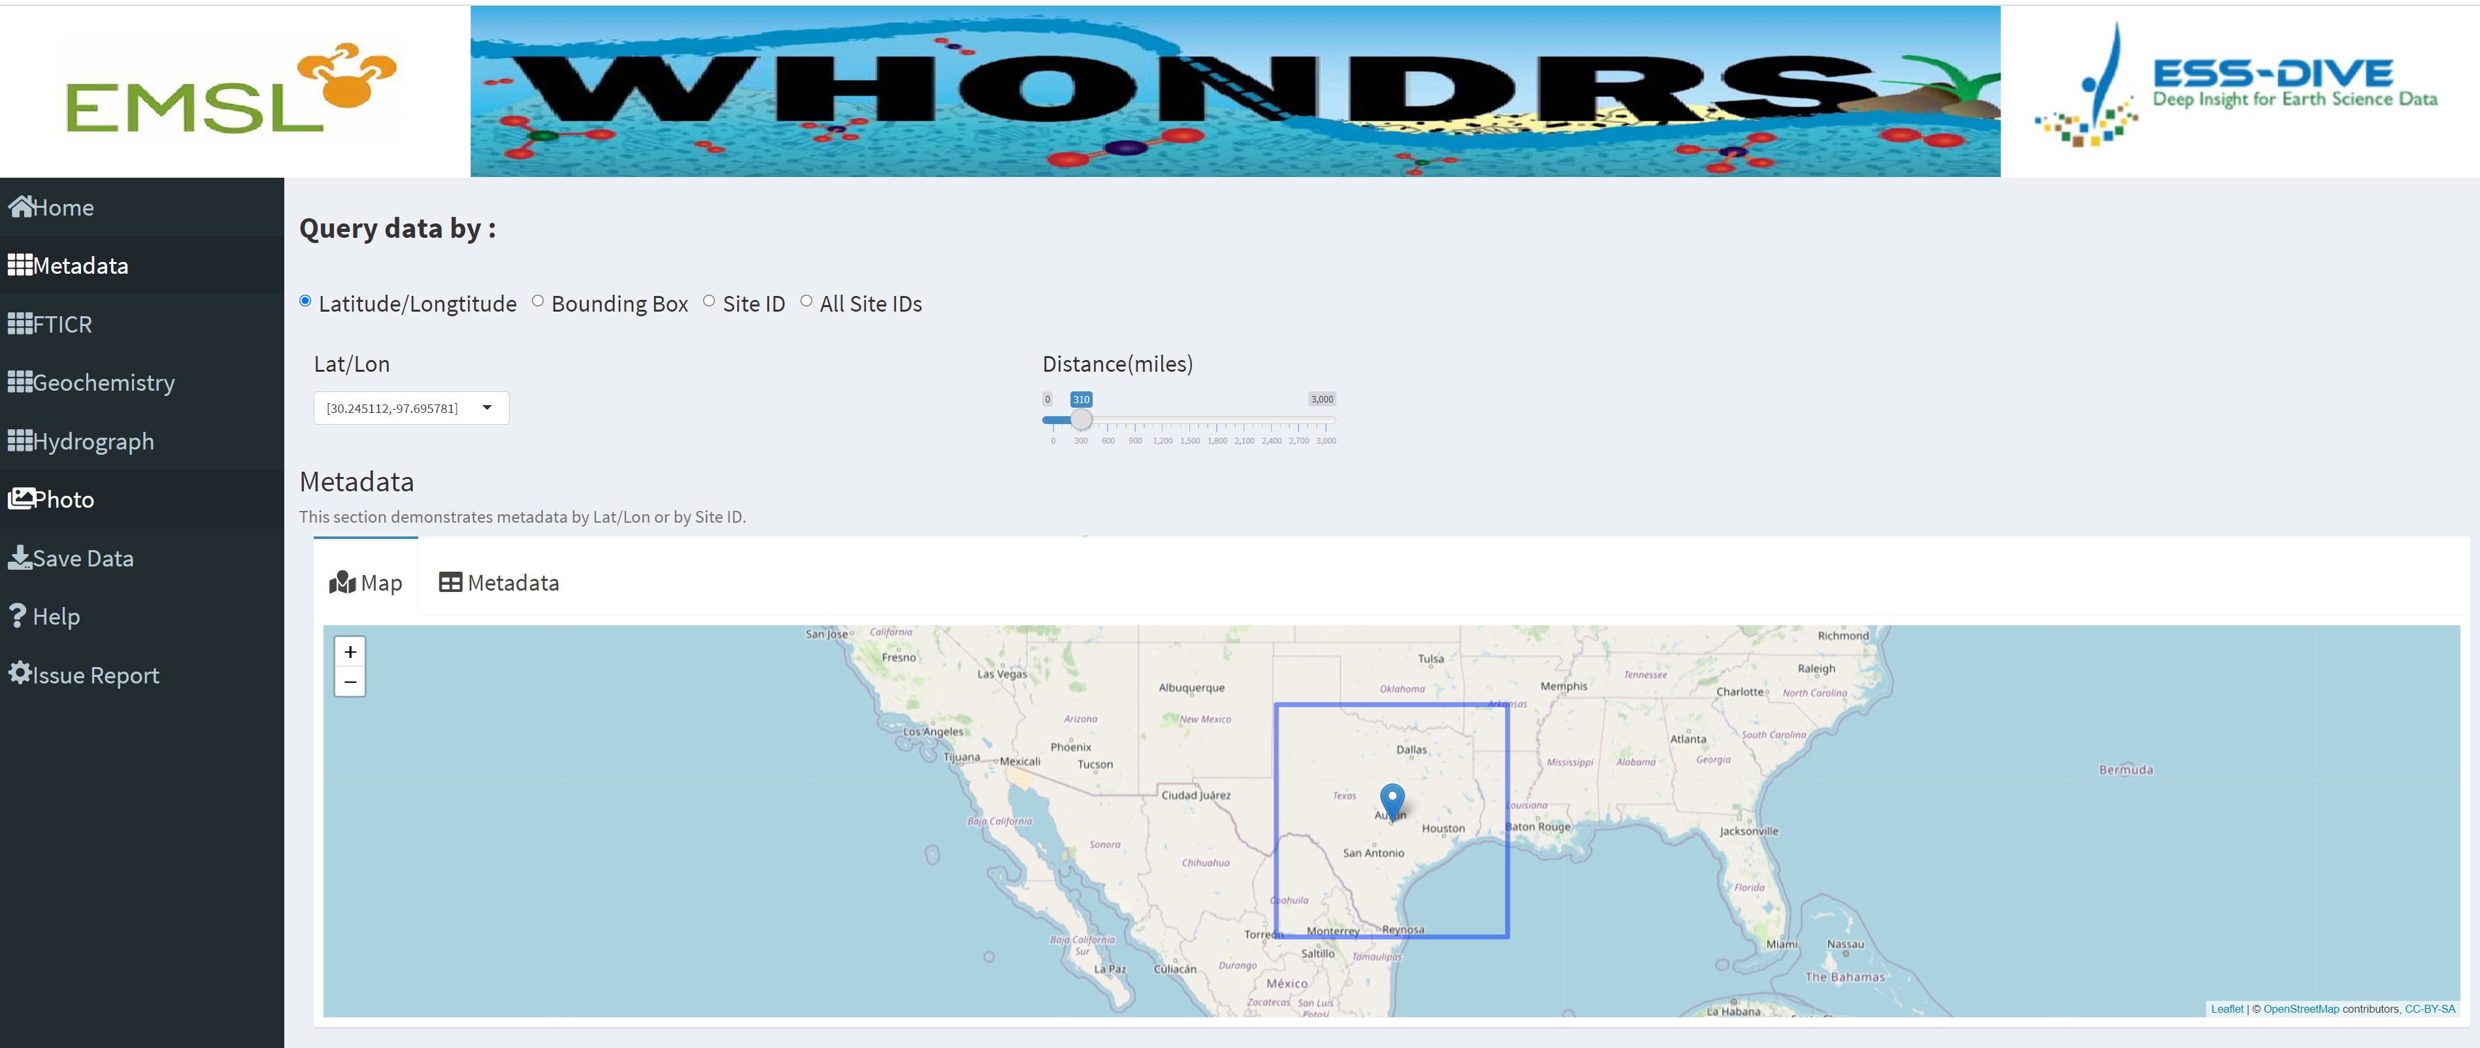
Reference
The WHONDRS-GUI is an important element of understanding connections among hydrologic, biogeochemical, and microbial function within river corridors. The GUI alone will not provide this understanding, however, and must be coupled with additional analyses and tools as well as additional data types that are not currently in the datasets. For example, detailed molecular properties of dissolved organic matter (DOM) are provided by the FTICR data, which can be paired with data on environmental characteristics (e.g., vegetation type, land use, ecosystem productivity, etc.) that are publicly available. Because all WHONDRS data are georeferenced, these additional environmental data can be extracted from other sources and paired with WHONDRS data to evaluate aspects of the environment that explain variation in DOM chemistry at the global scale. Outcomes of such analyses would provide novel hypotheses to be evaluated through additional sampling, experimentation, and/or modeling.
https://xmlin.shinyapps.io/whondrs/

Slide 10
Next steps
Apply unsupervised to both water and sediment to get clusters
Water clustering – cluster 1,2,3
Sediment clustering - cluster 4,5,6
Miko to send over file with “site ID” and cluster label
Clusters label (1,2,3,4,5,6) as “target” to Florina’s model (with combined dataset as the main input data)
New unseen data as testing for Flo’s model

